Slide 1
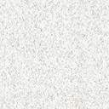

Prototype Presentation
Melissa Fruci, Jason Adams, Russell Robertson, Samuel Reed, Elijah Cook, Nikhil Arora

Slide 2
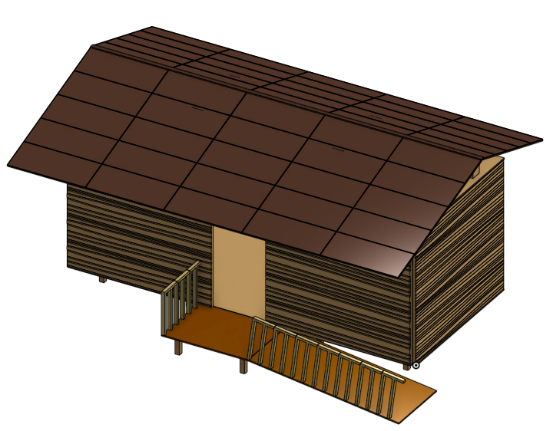
Front Approach
Ramp of 1:15 slope for wheelchairs
Gentle steps up
Swing outwards door
Sound and visual wall
Tamped earth path
Quiet Signs

Slide 3
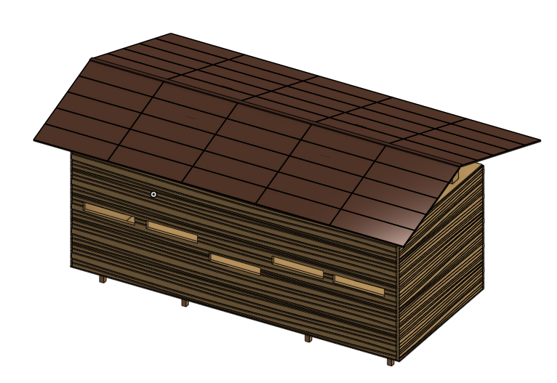
Viewing Side
Slits at various heights to accommodate adults, children, and those in wheelchairs.
Windows
Bare wood finish to blend in

Slide 4
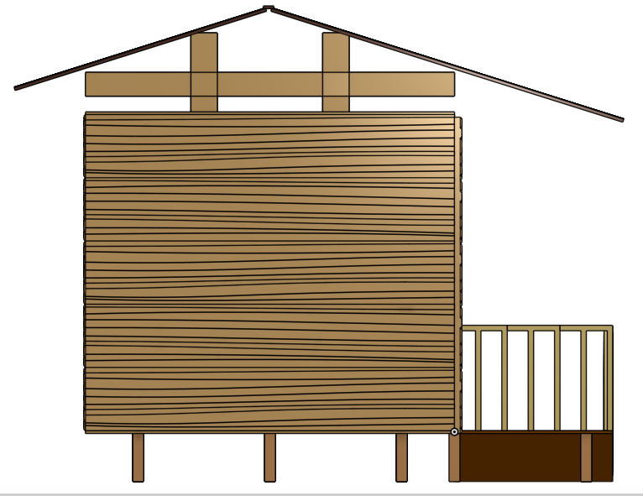
Roof and Rafters
Space between flat roof and angled roof for bird nesting
Custom nest cups for barn swallows
Eco-Friendly roof tiles

Slide 5
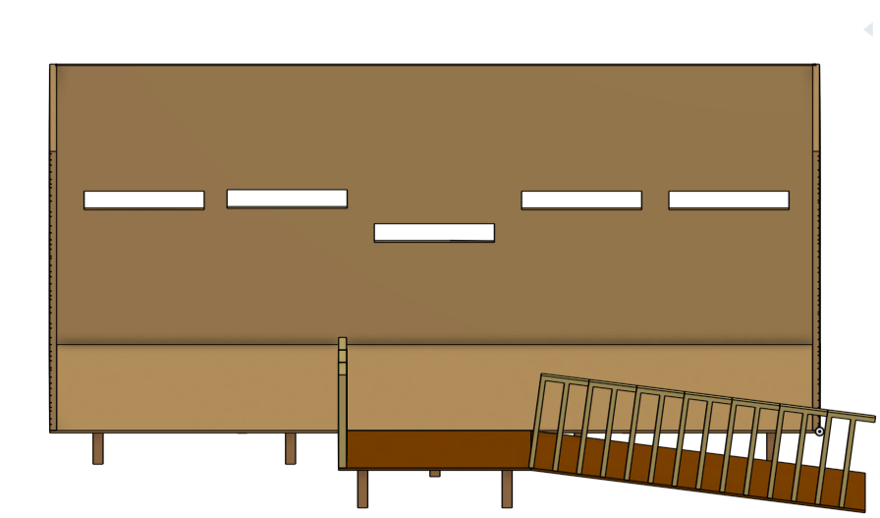
Interior Design
Movable benches
Window slits to adjust viewing height
Arm cushions at bottoms of windows
Garbage can with animal safe lid
NCC visual resources
Short shelf running length of viewing wall

